Slide 1
Cover
University Stakeholder Meeting

Slide 2
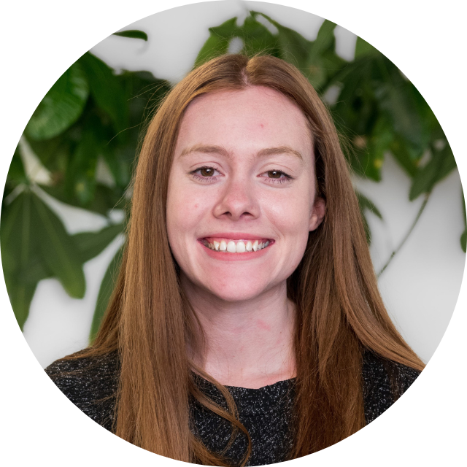
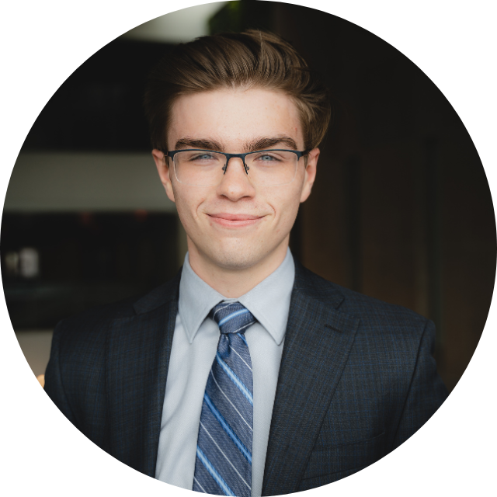
v
Meet the Key Players
Meet the Key Players
Hannah Whale,
Student Groups Administrator
Logan Breen,
Vice-President Internal
Carleton University
Peter Cech, RM
Clubs Oversight Commission

Slide 3
Division of Duties
Carleton
CUSA
Manages Carleton’s Insurance
Manages Risk Management form
Reviews and provides feedback on submissions
Manages Risk Management process and policies for Carleton University
Manages CUSA’s Insurance
Waivers
Encourages clubs to follow Carleton’s Risk Management policies and processes
Manages CUSA Clubs
Sanctioning, maintains the list of certified clubs

Slide 4
Higher Risk Activities
Store the waiver in a safe, secure location
Waiver from club members
Fill out CU’s Risk Management forms
Apply for certification
4
3
2
1
Apps. always open
Form available online
Does not need to be sent to CUSA. Club executives store them
Need a waiver for each new activity

Slide 5
FAQs
01
“Do we really need a new waiver each time?”
03
“I need a copy of the insurance.”
05
“Do I need to send the waivers to CUSA?”
02
“I haven’t heard back from CUSA about our RM form.”
04
“I need to a third-party to your insurance policy.”
06
“Our club is going on an international trip…”

Slide 6
Thank you
Thank you!
Check out cusaclubs.ca for resources

