Slide 1
Co-Curricular Record
Student Experience Office

Slide 2
Overview
What is the CCR?
Why use the CCR?
How to use the CCR
Important dates and deadlines

Slide 3
What Is the Co-Curricular Record?
“The Co-Curricular Record (CCR) system is a resource offered to all Carleton students as a way to record and encourage involvement in student leadership development, extracurricular activities, and community service opportunities.”

Slide 4
CCR Terminology
Activity: Involvement opportunity.
Position: What is added to your record.

Slide 5
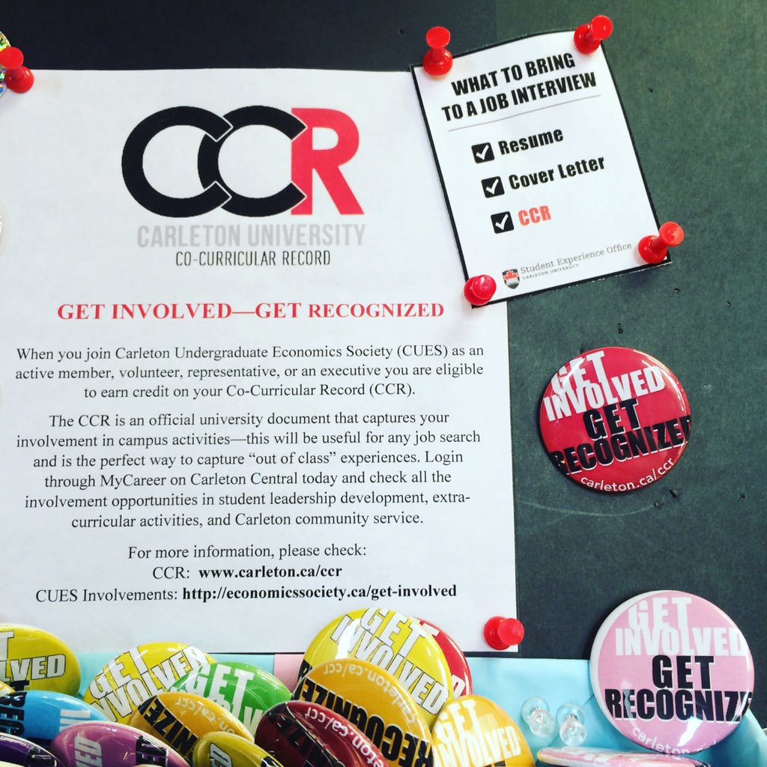
Why Use the Co-Curricular Record?
It tracks your on-campus involvements
Clubs and societies
On-campus volunteer opportunities
Academic opportunities outside of your credited course
You can present it as an official documentation to perspective employers on or off campus!
Attach it with you resume and cover letter!

Slide 6
CUSA Club President Outreach
EXAMPLE FOR CUSA CLUBS
Category: Clubs, Societies, Associations
Organization: Carleton University
Department: CUSA Clubs and Societies
Activity: Carleton Plant Society
Emails sent to CUSA Club Presidents regarding current positions and steps on how to properly navigate CCR to your club.

Slide 7
Access the CCR
Students can access the CCR through https://mysuccess.carleton.ca
using your CMAIL / CUNET Account

Slide 8
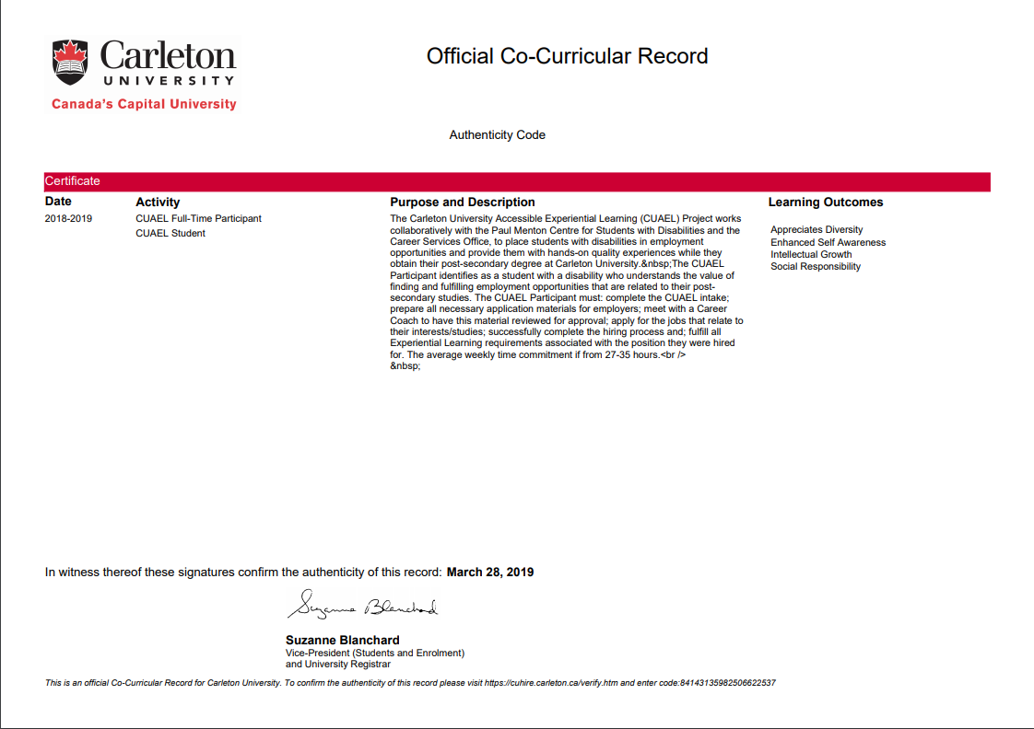
Example of printed CCR

Slide 9
Dates And Deadlines
C
April 26 is the last day to add any new positions or activities to the CCR directory. (Event/Program organizers)
May 10 is the last day to add positions to your personals record. (Students/Participants)
May 31 is the last day for validators to validate all student’s submissions. (Event/Program organizers)
C
R

Slide 10
Questions
CCR@Carleton.ca
https://carleton.ca/seo/ccr/

